Slide 1

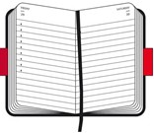


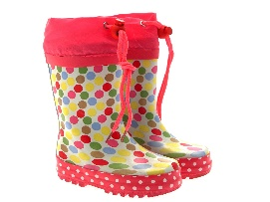
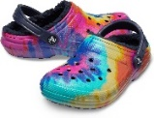
NEWSLETTER
Autumn Term 2026
Key Dates:
Start of term – Monday 7th September
Half Term – 19th – 30th October
London Trip – Thursday 19th November
Christmas Play – Wednesday 16th & Thursday 17th December @ 13.00
Christmas Party – Friday 18th December 10-13.00
End of term – Friday 18th December
Welcome to our new families joining Bright Sparks, here’s to a fab Autumn term.
Please note Mrs Johnson will be off this term.
Staff Working Days: This can vary from time to time:
Days | Staff
Mon | Hannah Wiltshire, Christy Holmes, Linda Johnson, Kat Corbyn, Michelle Keates, Bethan Cox, Lola Noyes & Debbie Froud
Tues | Hannah Wiltshire, Christy Holmes, Linda Johnson, Bianca Inwood, Char Fry, Kat Corbyn, Michelle Keates & Bethan Cox
Wed | Hannah Wiltshire, Christy Holmes, Linda Johnson, Charlene Fry, Bianca Inwood, Bethan Cox, Lola Noyes & Debbie Froud
Thurs | Michelle Keates, Linda Johnson, Charlene Fry, Bianca Inwood, Bethan Cox, Hannah Wiltshire & Debbie Froud
Fri | Christy Holmes, Linda Johnson, Charlene Fry, Kat Corbyn, Bethan Cox, Lola Noyes & Debbie Froud
Reminders
Fees are due on first of every invoiced month to avoid confusion
Please chop grapes & olives lengthways in lunches to avoid choking
Don’t forget no chocolate or nuts including chocolate spread & peanut butter
Provide suitable clothing for the weather. Apply sun cream before drop off
Please relay messages to the staff member taking your child or email Debbie.
Please check emails for accident forms
Website
Keep up to date with our website
We are on Facebook, please check us out & write a review
Don’t forget to let us know any compliments, Complaints & Suggestions. We value your feedback.
If you feel your child would be interested in a certain topic please let us know for our future planning.
Please note our email address:
debbie.brightsparks@outlook.com
Please call 01276 677415
if your child cannot attend
Remember
Family Pictures – send in first week
Forest school
Ensure if your child has suitable clothing. Debbie will advise which children.
All Children wear boots/trainers to school and leave named Crocs at school.
Easter egg wrappers
Old baby bottles
Toilet rolls

